Slide 1
The Power of Steadfastness
Adrian Liew
10/02/2019

Slide 2
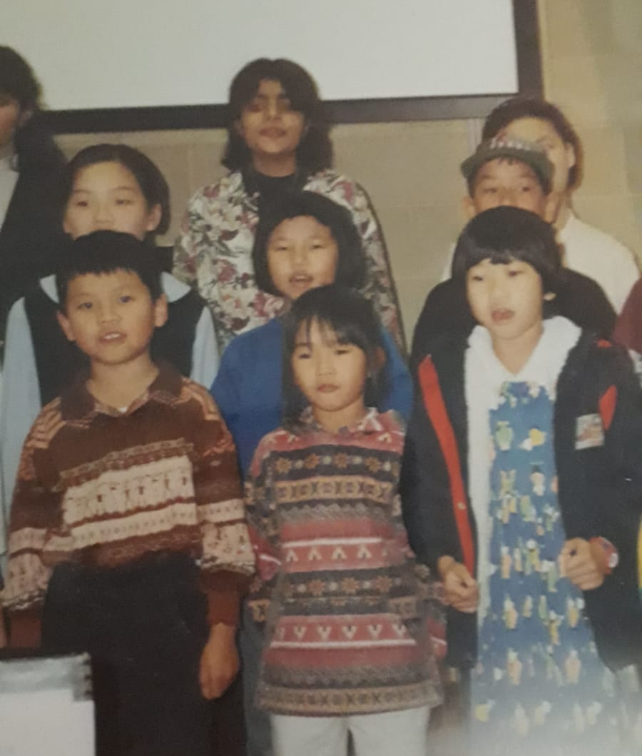
Man, those were the days…

Slide 3
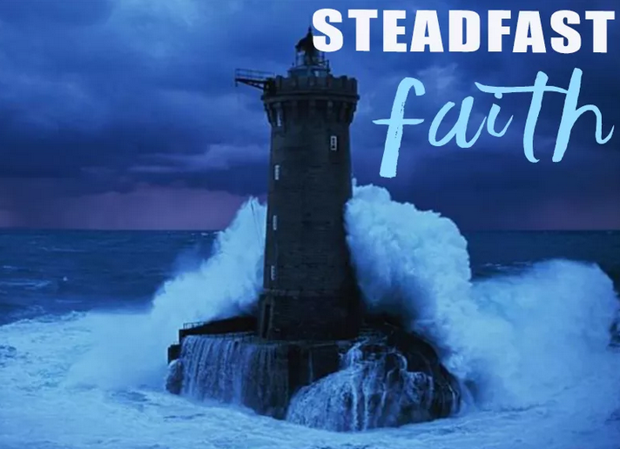
Power of Steadfastness
The ability to stick things out not for the sake of just sticking things out but believing that you will eventually see the breakthrough.

Slide 4
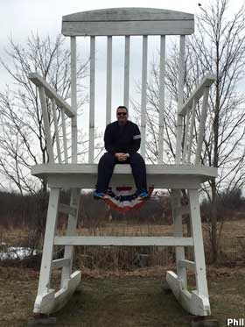
Steadfast in the Greek
Greek concordance (hedraios)
sitting down firmly
Greek Lexicon
- immovable

Slide 5
Lamentations 3:21-23
21 But this I call to mind,
and therefore I have hope:
22 The steadfast love of the Lord never ceases;
his mercies never come to an end;
23 they are new every morning;
great is your faithfulness.

Slide 6
There is a power in steadfastness, there is power in faithfulness, there is power in having grit to push through and stick things out even though things aren’t going
so great.

Slide 7
Hebrews 3:12-15
See to it, brothers and sisters, that none of you has a sinful, unbelieving heart that turns away from the living God. But encourage one another daily, as long as it is called “Today,” so that none of you may be hardened by sin’s deceitfulness. We have come to share in Christ, if indeed we hold our original conviction firmly to the very end. 15 As has just been said:
“Today, if you hear his voice,
do not harden your hearts
as you did in the rebellion.”

Slide 8
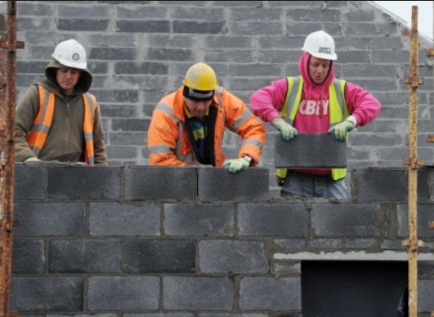
3 Guys Building a Wall
I’m building
a House of God
I’m building
a wall
I’m building
a church

Slide 9
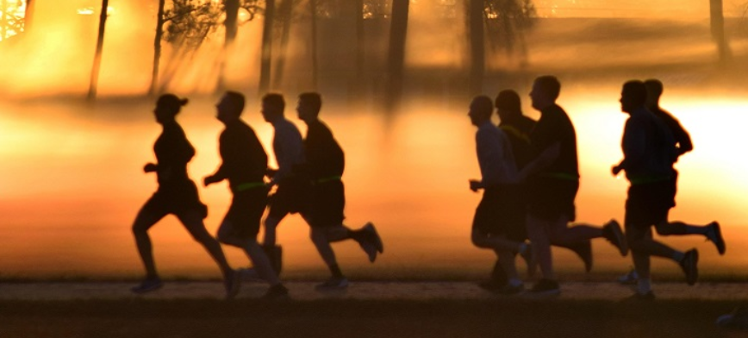
Lessons on Being Steadfast and Faithful
1) Priority of His Presence
2) Simple Obedience
3) Pushing through with endurance
4) Pushing through when we don’t feel the passion

Slide 10
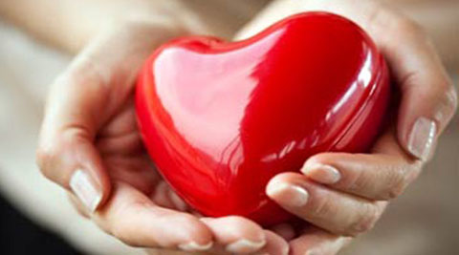
Hindrances to being Steadfast and Faithful
Misplaced Morality
Unresolved Issues of the Heart

Slide 11

1 Corinthians 15:58
Therefore, my beloved brethren, be steadfast, immovable, always abounding in the work of the Lord, knowing that your labor is not in vain in the Lord.

